Slide 1
Beneficial Bayes
Bayesian Carbon Prediction Models:
Quap vs MCMC comparison with stand-level variables
Tara Skiba
WFS 560 Final Project
December 8, 2025

Slide 2
Introduction to carbon models
Carbon – hot field ($$$) and growing climate concerns
Quantifying live aboveground carbon (ABG or C) – accurately!
Recently updated carbon biomass equations (species specific)¹
Previous frequentist approach – linear mixed-effect model
Quick, accurate, works well on large areas²
Locally calibrated and deployed, limited use outside of calibrated region
Only coefficients are passed to new observations
Benefits of a Bayesian approach
Passing along the posterior distribution for coefficients provides flexibility in new datasets³
Increases predictive accuracy in new observations
More useful to small landowners with land outside original region but may match in forest species composition.
Currently used frequently in handling remotely sensed/geospatial data^{4,5}

Slide 3
Introduction to carbon models
Carbon – hot field ($$$) and growing climate concerns
Quantifying live aboveground carbon (ABG or C) – accurately!
Recently updated carbon biomass equations (species specific)¹
Previous frequentist approach – linear mixed-effect model
Quick, accurate, works well on large areas²
Locally calibrated and deployed, limited use outside of calibrated region
Only coefficients are passed to new observations
Benefits of a Bayesian approach
Passing along the posterior distribution for coefficients provides flexibility in new datasets³
Increases predictive accuracy in new observations
More useful to small landowners with land outside original region but may match in forest species composition.
Currently used frequently in handling remotely sensed/geospatial data^{4,5}

Slide 4
Data
Great Smoky Mountains National Park
Oak-hickory forests
Forest Inventory and Analysis (FIA) long-term forest monitoring program
Permanent plot data – repeated plot measurements ~5 years
Plots are individual units
392 observations, 137 unique plots
C: cpa (in MgC/ha)
quad. mean diameter (qmd), basal area/ha (baph), trees/ha (tph), mean diameter (md), mean height (h), mean H:D (hd), slope, aspect, stand density index (sdi)

Slide 5
Proposed question:
We have a previous frequentist linear mixed-effects model^{2,6} (simple), a linear model fit with quap (complex), and a hierarchical MCMC model (most complex) with stand-level inventory variables…
Do more complex Bayesian models have stronger prediction power for carbon over their simple counterparts?
How do the 2 Bayesian models compare in carbon predictions and usability?

Slide 6
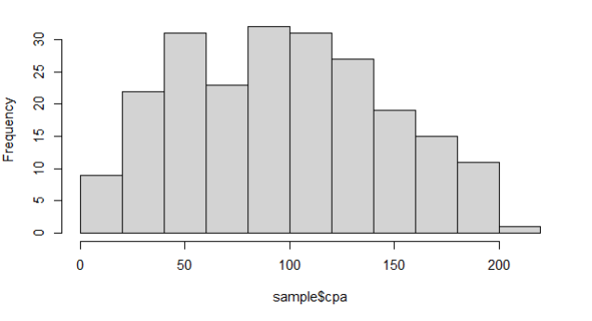
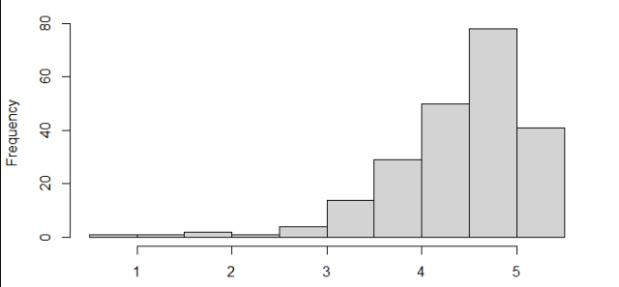
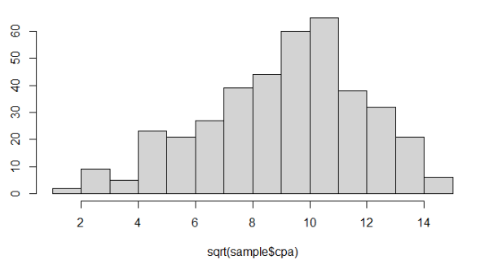
Preliminary data exploration
C must be positive
scale – issues with shared values, using testing datasets
Log transformation
Sqrt transformation
Predictors variable: all +, but untransformed (focusing on prediction power)
C
log(C)
C^{0.5}

Slide 7

Preliminary data exploration
C must be positive
scale – issues with shared values, using testing datasets
Log transformation
Sqrt transformation
Predictors variable: all +, but untransformed (focusing on prediction power)
C
log(C)
C^{0.5}
$$β_{0}\sim Normal\left(10,4\right)$$

Slide 8
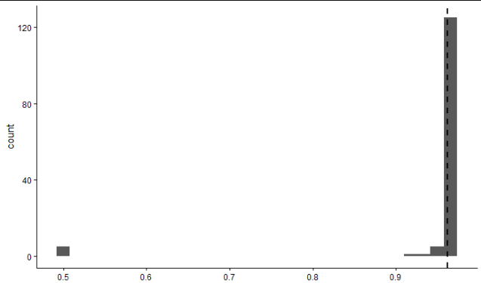
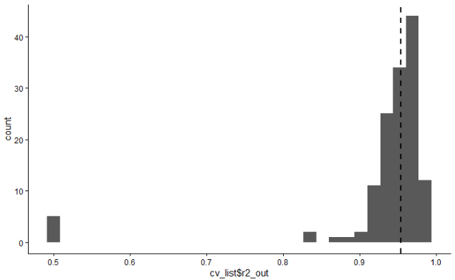

Linear quap with LOGO-CV
Quap
$$\sqrt{C}\sim Normal\left(μ,σ\right)$$
$$μ= β_{0}+β_{1}qmd+β_{2}baph+β_{3}tph+$$
$$β_{4}d+β_{5}h+β_{6}hd+β_{7}slope+β_{8}aspect+β_{9}sdi$$
$$β_{0}\sim Normal\left(10,4\right)$$
$$σ\sim Exponential\left(1\right)$$
$$β_{1},…,β_{9}\sim Normal\left(0,3\right)$$
Pseudo-LOGO-CV
Leave-on-group-out cross-validation
All repeated measurements for a plot is considered a group
Fits model n times (number of groups)
Not good representation of testing model with new inventory (many new plots)
90/10 split In-Bag and Out-Of-Bag datasets (common frequentist approach)
Split on plot IDs – 9 plots in OOB dataset
Simulates small area estimation
Wide variability in prediction performance over runs
R-sq varies drastically – essential to cross-validate
In practice, use individual model with good predictability
IB R²
OOB R²

Slide 9
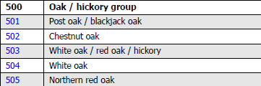
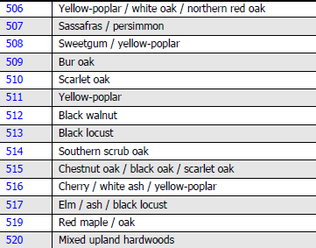
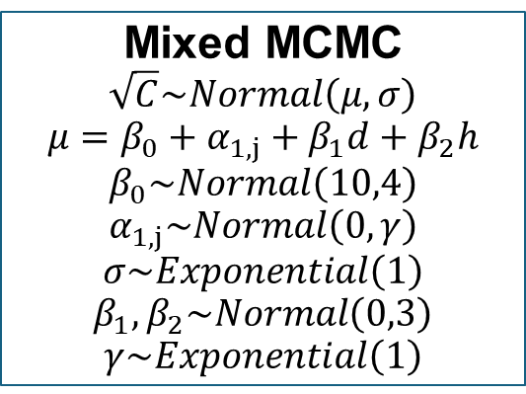
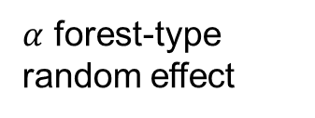
Mixed-MCMC
Mixed MCMC
$$\sqrt{C}\sim Normal\left(μ,σ\right)$$
$$μ=β_{0}+α_{1,j}+β_{1}d+β_{2}h$$
$$β_{0}\sim Normal\left(10,4\right)$$
$$α_{1,j}\sim Normal\left(0,γ\right)$$
$$σ\sim Exponential\left(1\right)$$
$$β_{1},β_{2}\sim Normal\left(0,3\right)$$
$$γ\sim Exponential\left(1\right)$$
$α$ forest-type random effect
Mixed-effect model
Random effect on forest type
Amount of C in a tree is species-dependent, based on tree form, specific density, and growth rates
Provides a global model with flexibility for different species compositions
13 forest types present
High multicollinearity between variables justifies simplified model
Same 90/10 IB-OOB data splitting as previous model

Slide 10
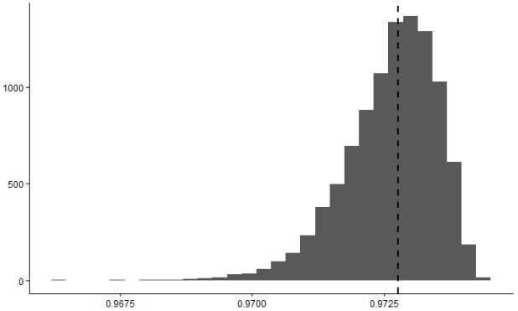
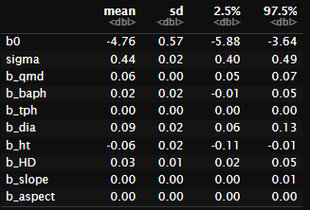
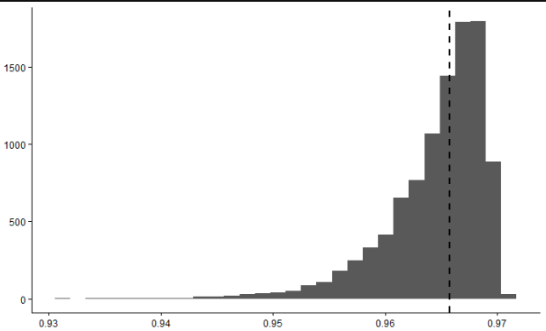
Quap Results
Model sometimes doesn’t converge – error handling required
Users need to make sure model used is sufficient
For a “good model”:
Overall excellent predictions
Median R² from CV-approach
IB R²
IB R²
OOB R²
OOB R²
Do not really interpret coeff.
Focus is predictive power

Slide 11
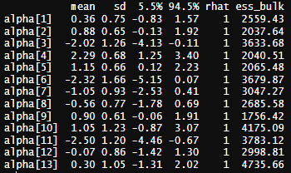
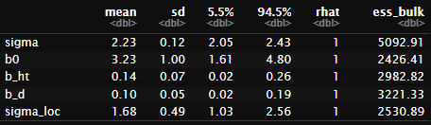
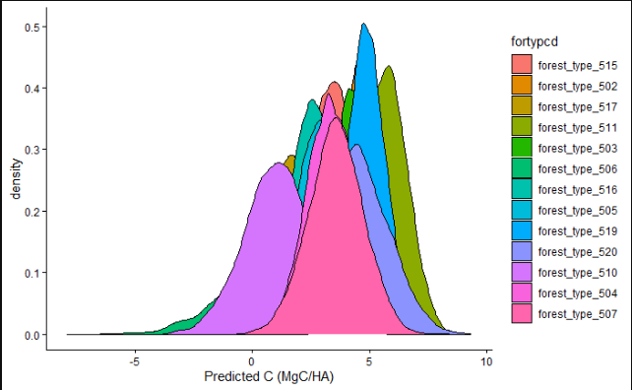
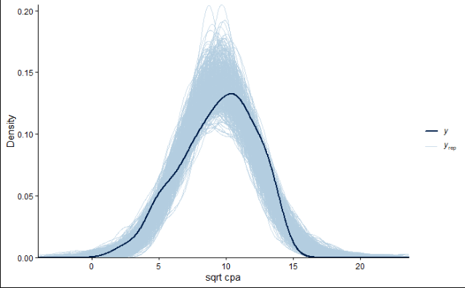
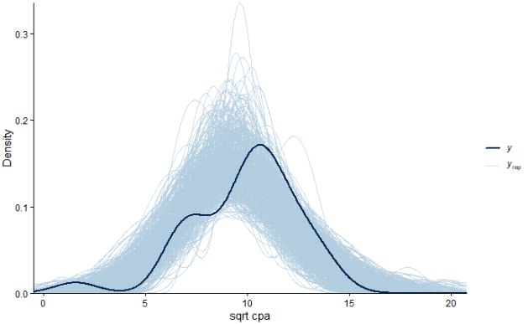
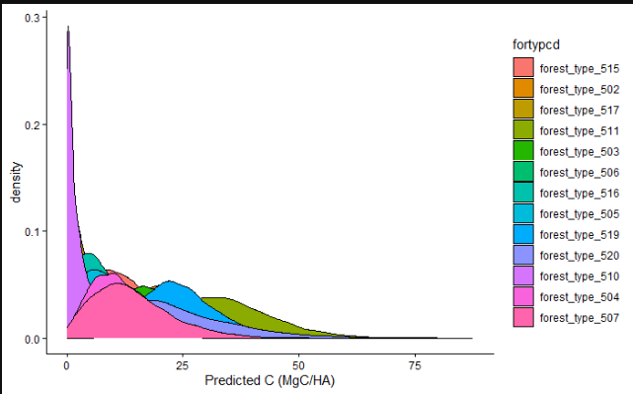
Mixed-MCMC Results
Random effect on forest type
Posterior validation checks look good
Trace and rank plots: appropriately fuzzy
Sqrt(cpa)
IB R²
OOB R²
back-transformed to cpa

Slide 12


Model Comparison
Quap
MCMC
lppd from quap LOGO-CV: -1728.332, compared to MCMC: -415.6192 and single quap: -123.2606
(probably not acceptable to compare these given the pseudo-LOGO-CV)
Quap model performed better than MCMC and frequentist lme model⁶
Despite wide variability of performance between quap model runs
MCMC can have more predictors added after handling multicollinearity – should increase predictive power

Slide 13

Remaining Issues
Predictions for sqrt(cpa) are good
Issues with back-transforming the data
Think: how will the resulting distribution change when you square values following a normal distribution?
Anything less than 1 gets smaller, larger values (>1) will blow up
Try Box-Cox transformation⁷ or untransformed data ($β_{0}\sim Normal\left(100,25\right))$
Simply scaling data isn’t easy in large datasets
Fine-tune priors needed
sqrt(cpa)
cpa

Slide 14
References
1 Westfall, J. A., Coulston, J. W., Gray, A. N., Shaw, J. D., Radtke, P. J., Walker, D. M., Weiskittel, A. R., MacFarlane, D. W., Affleck, D. L. R., Zhao, D., Temesgen, H., Poudel, K. P., Frank, J. M., Prisley, S. P., Wang, Y., Meador, A. J. S., Auty, D., & Domke, G. M. (2024). A national-scale tree volume, biomass, and carbon modeling system for the United States. Gen. Tech. Rep. WO-104. Washington, DC: U.S. Department of Agriculture, Forest Service., 104. https://doi.org/10.2737/WO-GTR-104
2 Yang, S.-I., Brandeis, T. J., & Skiba, T. (2025). Quantifying Stand-level Carbon Using an Alternative Method: A Case Study of National Forests and Parks in Southern Appalachian Mountains. Journal of Forestry, 123(5), 653–674. https://doi.org/10.1007/s44392-025-00044-x
3 McElreath, R. (2020). Statistical rethinking: A Bayesian course with examples in R and Stan (Second edition). Chapman & Hall/CRC.
4 Chinembiri, T. S., Mutanga, O., & Dube, T. (2022). Landsat-8 and Sentinel-2 Based Prediction of Forest Plantation C Stock Using Spatially Varying Coefficient Bayesian Hierarchical Models. Remote Sensing, 14(22), 5676. https://doi.org/10.3390/rs14225676
5 Finley, A. O., Banerjee, S., Ek, A. R., & McRoberts, R. E. (2008). Bayesian multivariate process modeling for prediction of forest attributes. Journal of Agricultural, Biological, and Environmental Statistics, 13(1), 60–83. https://doi.org/10.1198/108571108X273160
6 Skiba, Tara. Dissertation (publication pending)
7 Chinembiri, T. S., Mutanga, O., & Dube, T. (2023). Hierarchical Bayesian geostatistics for C stock prediction in disturbed plantation forest in Zimbabwe. Ecological Informatics, 73, 101934. https://doi.org/10.1016/j.ecoinf.2022.101934

